Slide 1

Data Visualization Final Project Car Purchase Price analysis
Lakshmi Venkat Sai Putta LPUTTA(807527687) Graduate Student

Slide 2
Introduction
The project looks at what affects people's decisions when they buy cars.
It uses information from 500 car buyers.
The study examines how factors like age, gender, income, debt, and net worth influence what cars people buy and how much they spend.
Different types of charts such as pie charts, bar graphs, and scatter plots are used to show these relationships clearly.
The analysis helps identify trends like which age groups buy expensive or cheap cars and if there are differences between men and women in car preferences.
This information can help car companies understand their customers better and improve how they market their cars.
The visual tools used in the project make the data easy to understand and show how different factors affect car buying.

Slide 3
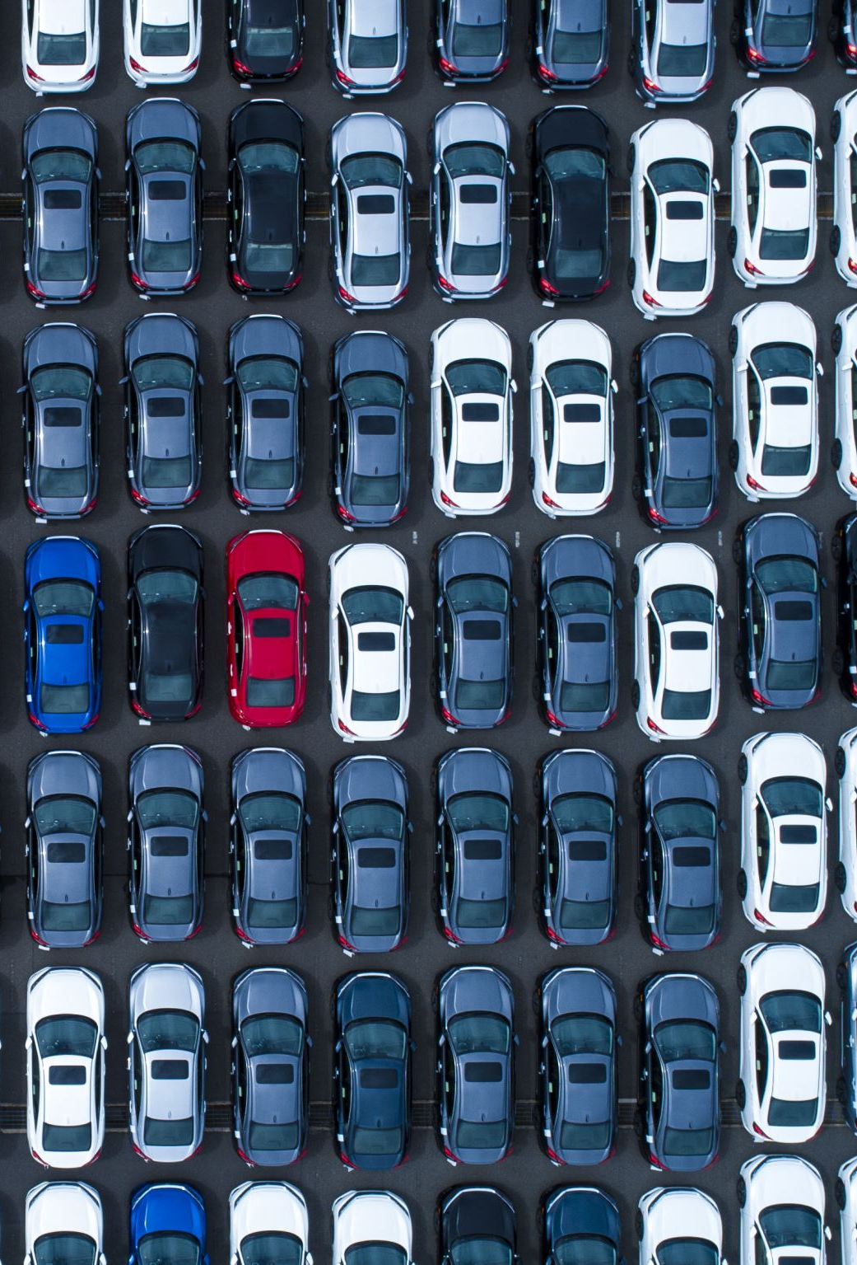
About Project
The project investigates why people choose specific cars and how much they spend, using information from 500 car buyers.
It explores factors like age, gender, income, debt, and overall wealth to see how they affect car buying choices.
Different charts were used to present the information: pie charts for gender differences, bar graphs for showing age and income, and scatter plots to connect financial status with car prices.
The findings show which age groups usually buy expensive or cheaper cars and if there are differences in car preferences between men and women.
This information is useful for car companies because it helps them understand their customers better and improve their marketing strategies.
The study also helps improve data analysis skills, especially in cleaning up data and combining information from various sources.
Overall, the project offers valuable insights into what influences people when they buy cars, which can help businesses target their products more effectively.

Slide 4
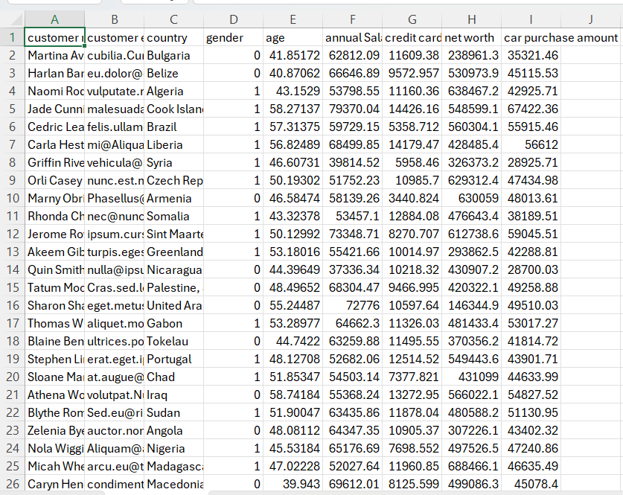
Dataset
The dataset includes information from 500 individuals who have purchased cars.
Each entry provides the buyer's age and gender, helping to analyze how different demographics buy cars.
Financial details such as annual income, credit card debt, and net worth are included for each buyer.
It records the amount each buyer spent on their car, offering insights into spending habits.
The country of residence for each buyer is also noted, allowing analysis of regional buying trends.
The data is clearly organized, making it easy to access and analyze.
The dataset contains both numerical data (like income) and categorical data (like gender), supporting a broad range of analysis methods.

Slide 5

Features Used
The data visualization project incorporates dynamic interactivity features tailored to each subproject.
Gender is analyzed to see differences in car preferences between males and females. This is visualized using a pie chart that adjusts according to different car price ranges.
Age of buyers is shown in a bar graph, where the x-axis is the frequency of transactions, and the y-axis represents the ages of buyers. This graph changes with different car price ranges to illustrate age-specific buying patterns.
Annual Salary, Credit Card Debt, and Net Worth are key financial metrics examined. Each is represented in a separate bar graph within the variable distribution section, showing how these financial factors correlate with car purchasing. These graphs also change according to different car price ranges, and they feature an option to change colors for clearer visualization.
The relationship between the car purchase amounts and the financial variables is further explored in a scatter plot. This plot varies according to different price ranges, with the y-axis representing the car purchase amount and the x-axis changing based on the selected financial variable (Annual Salary, Credit Card Debt, or Net Worth).

Slide 6
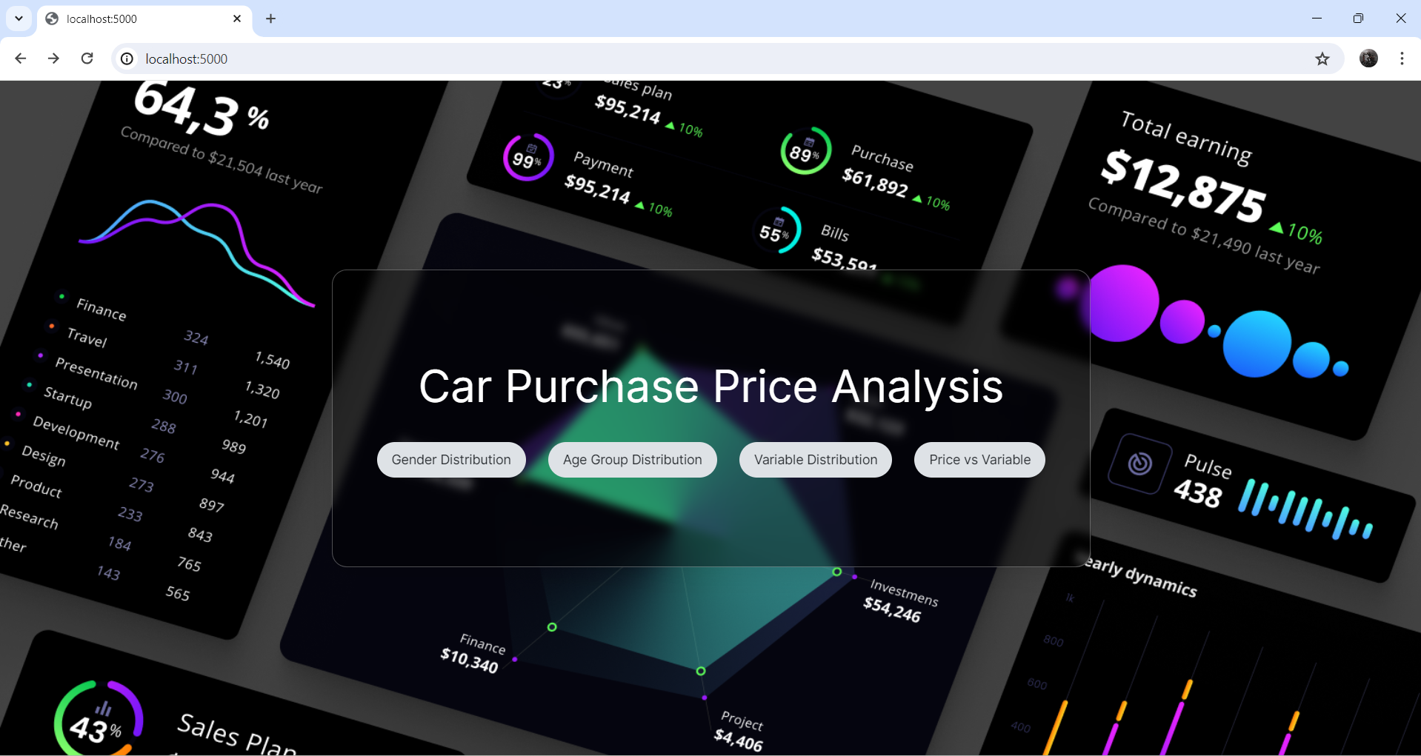

Slide 7
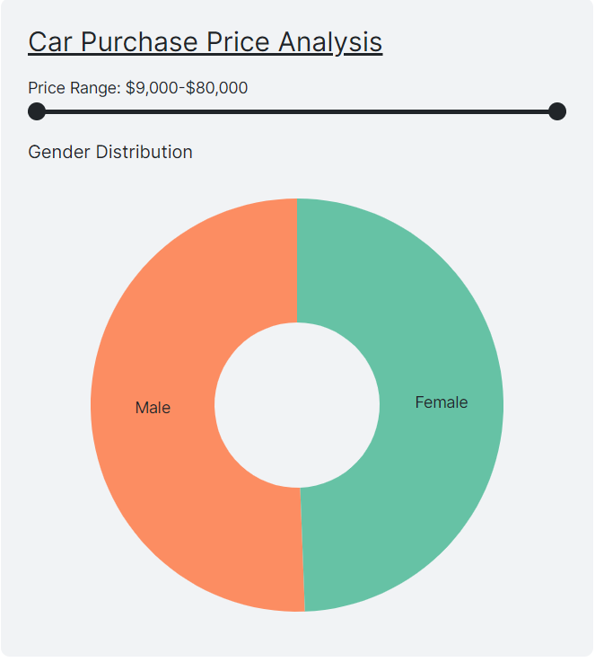
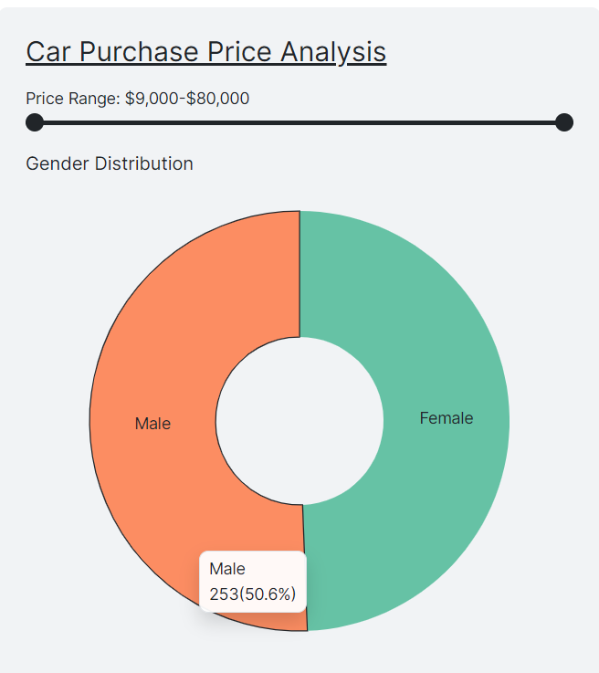

Slide 8
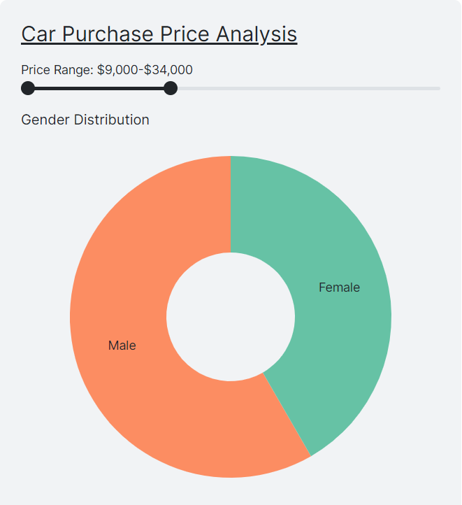
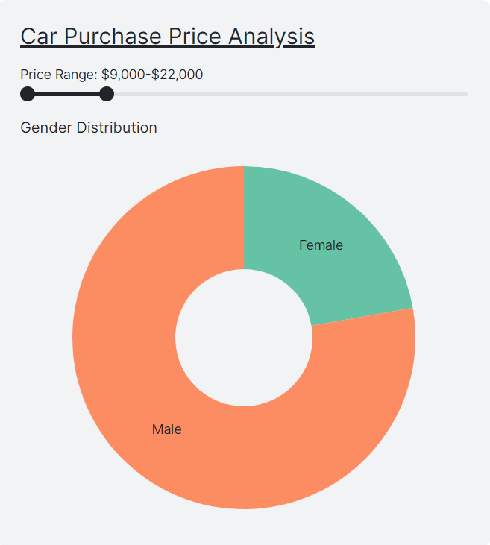

Slide 9
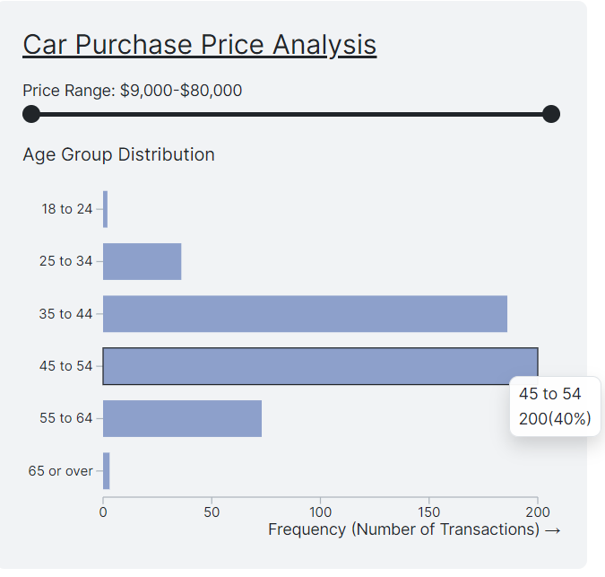
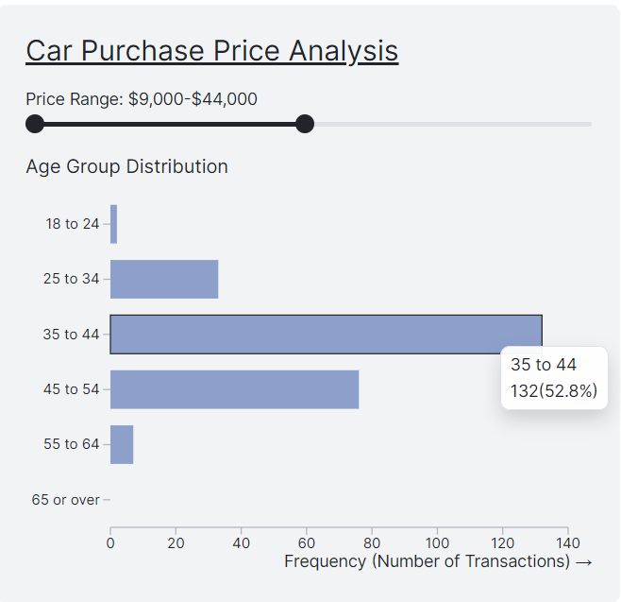

Slide 10
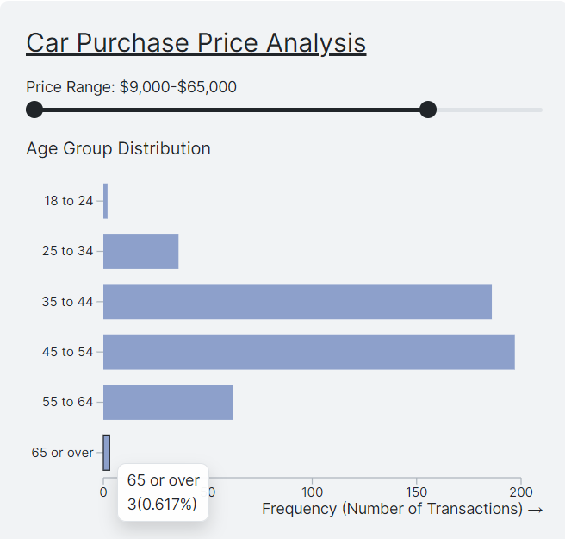
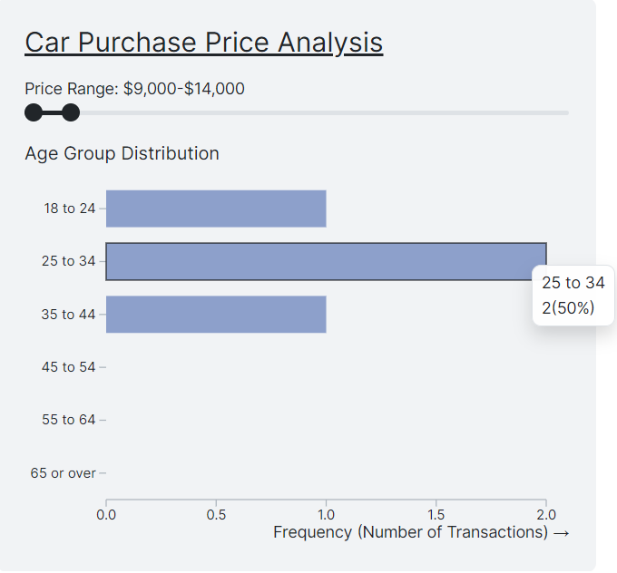

Slide 11
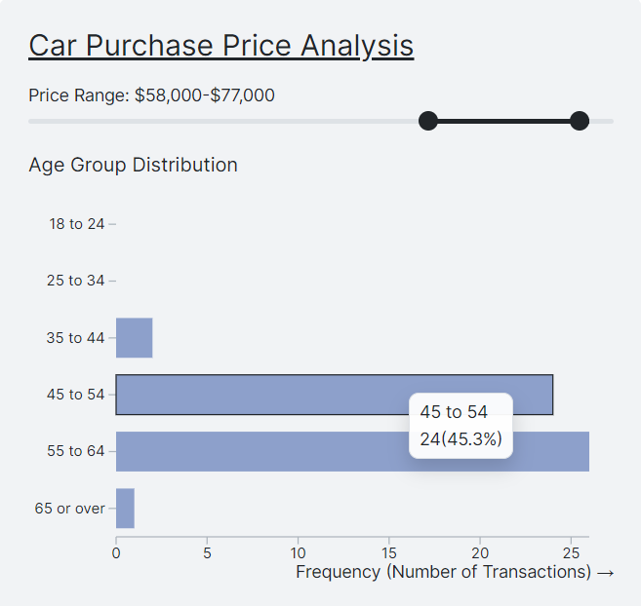
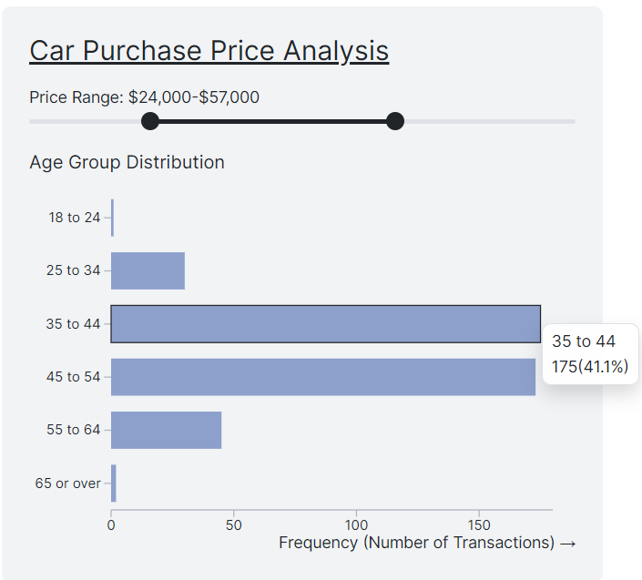

Slide 12
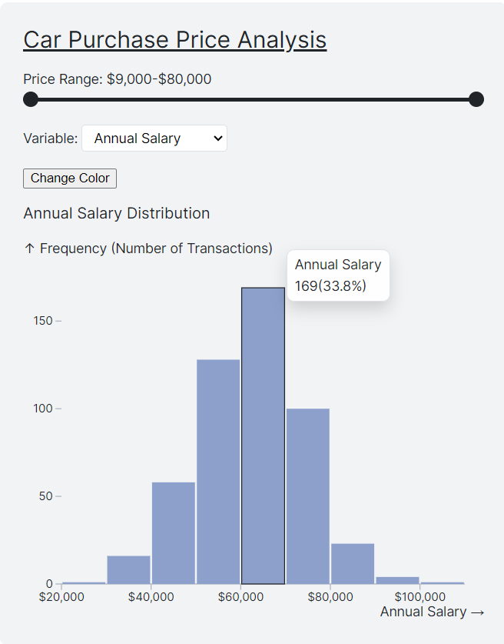
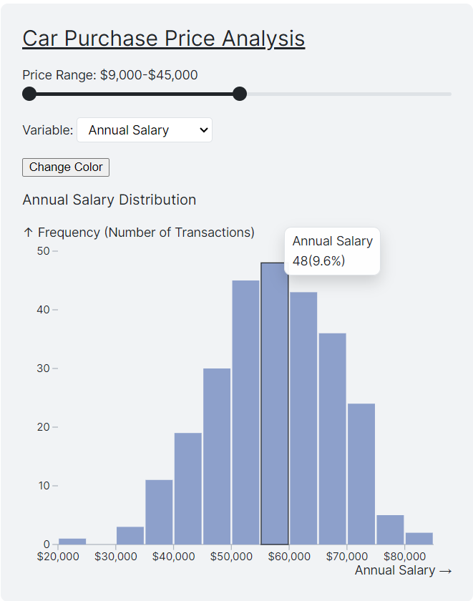

Slide 13
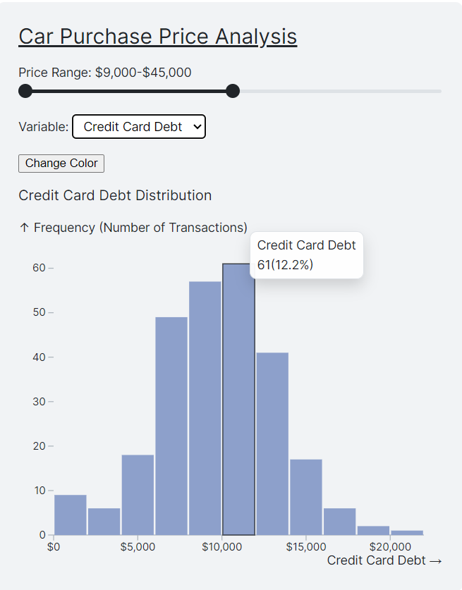
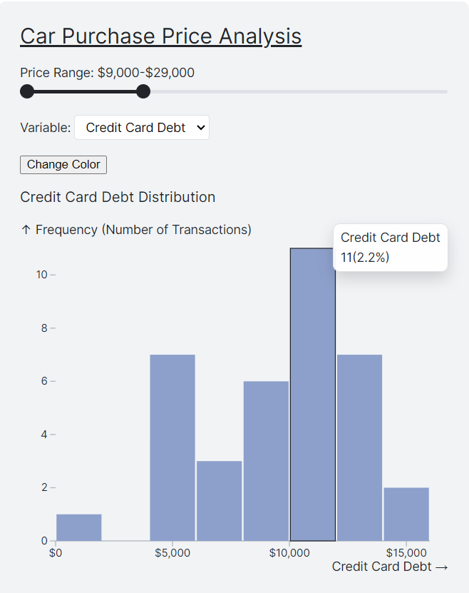

Slide 14
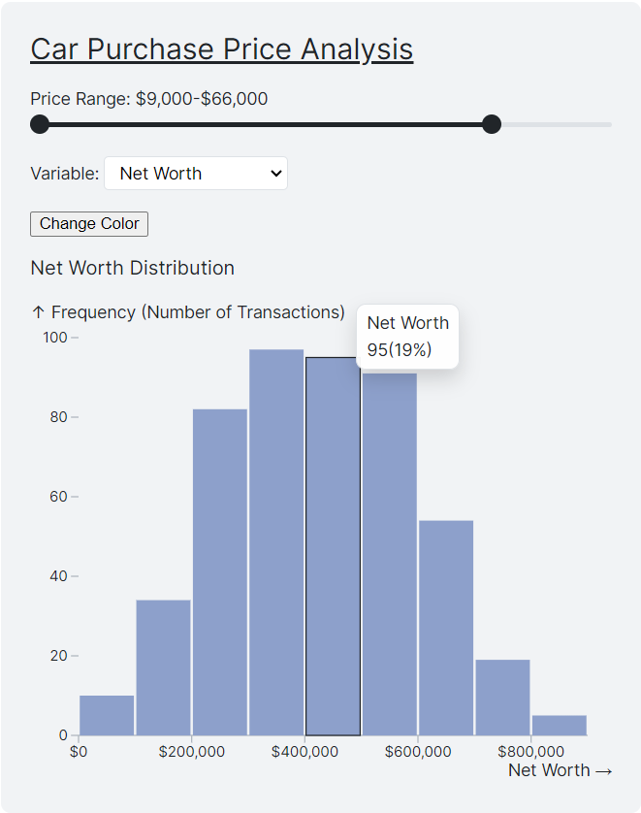
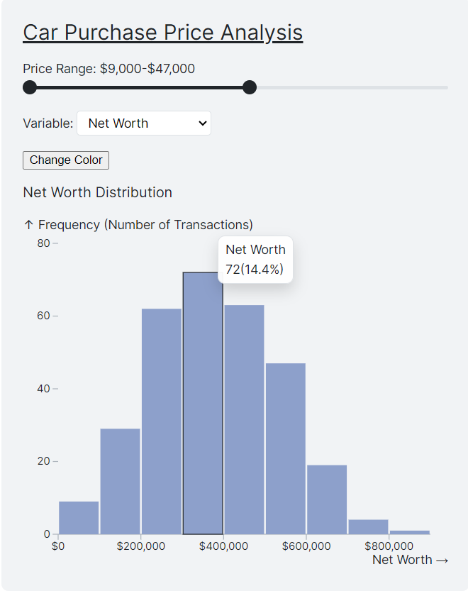

Slide 15
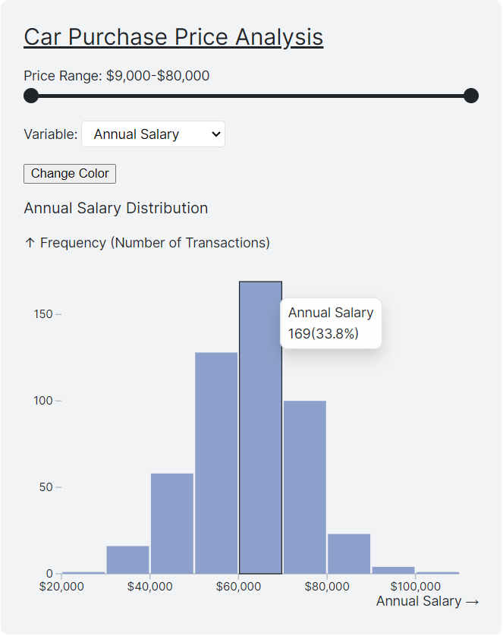
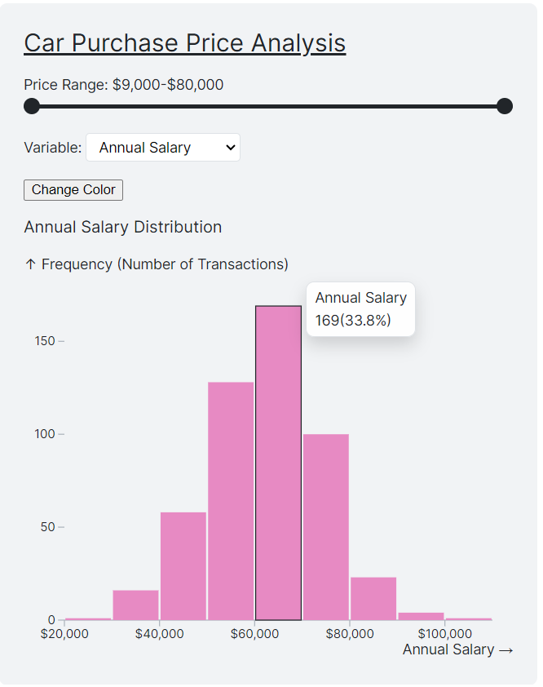

Slide 16
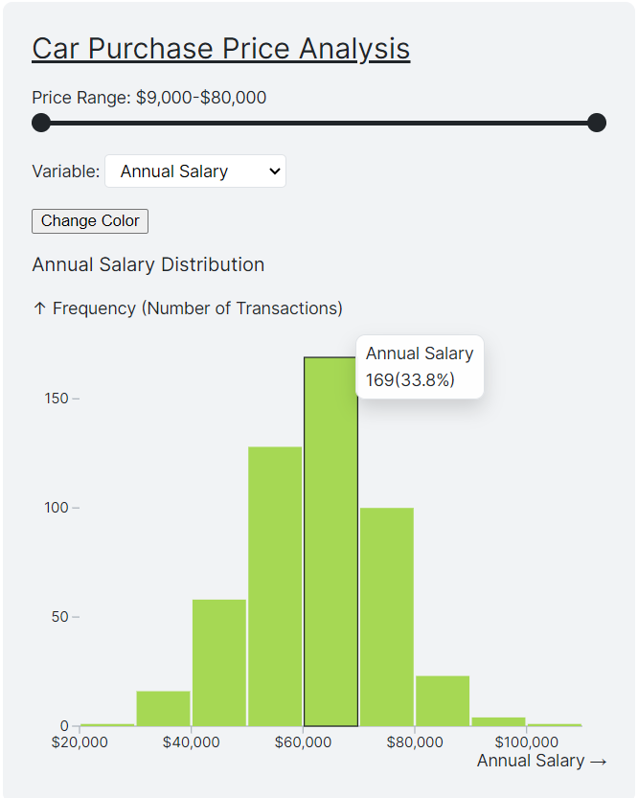
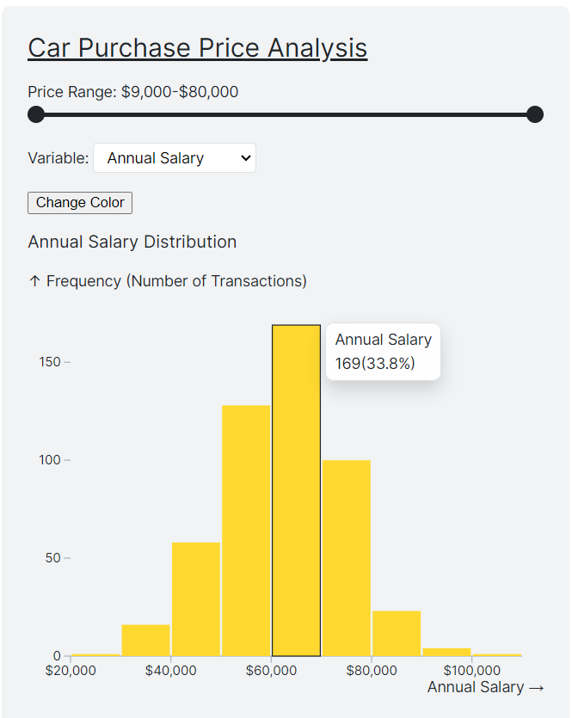

Slide 17
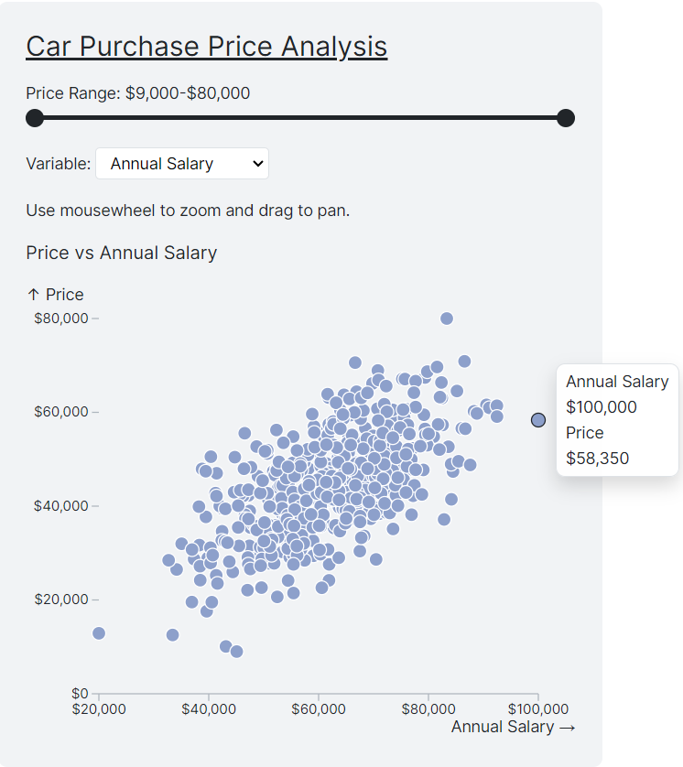
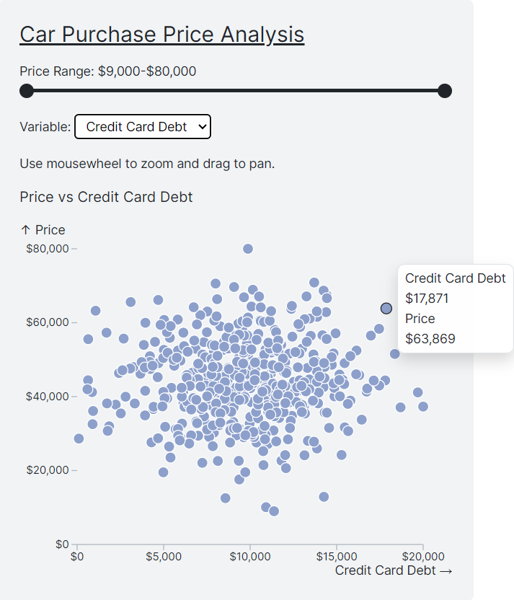

Slide 18
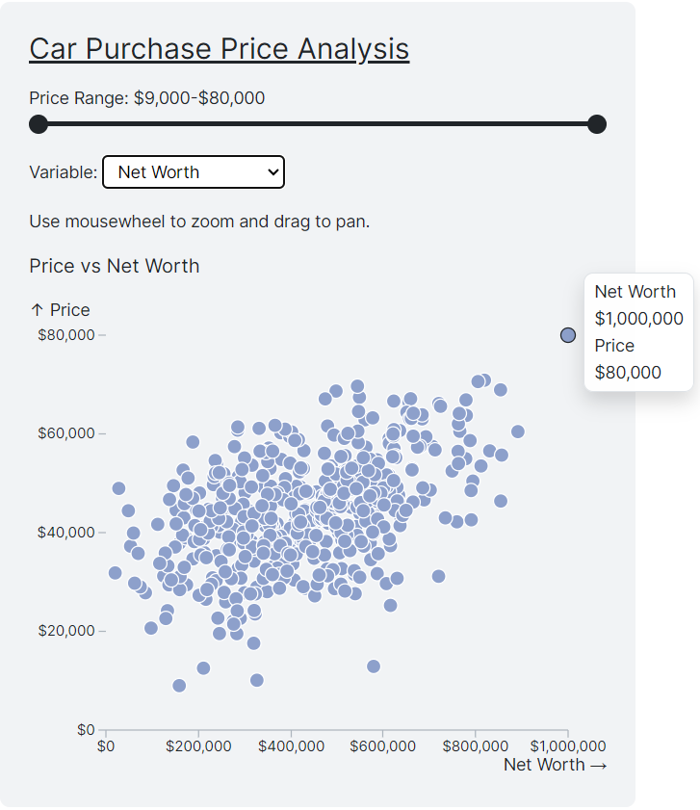
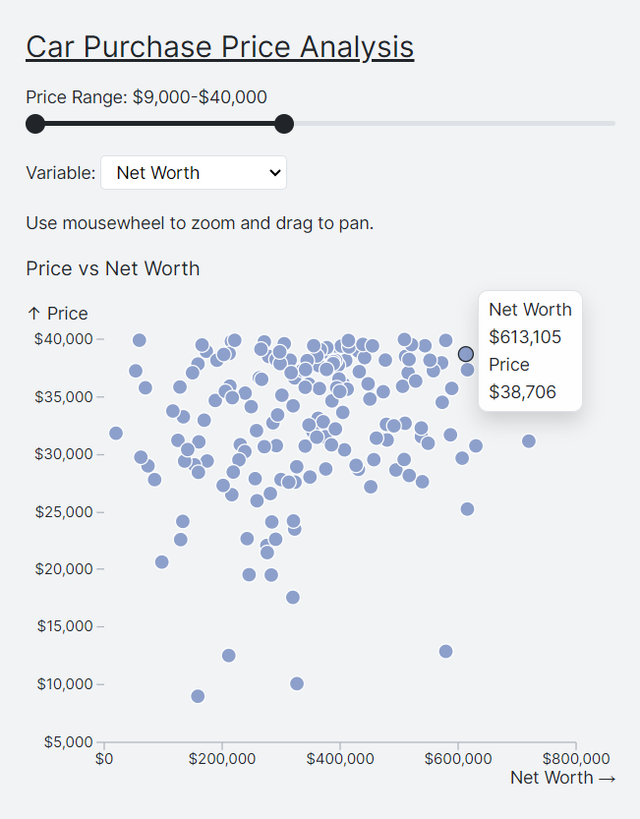

Slide 19
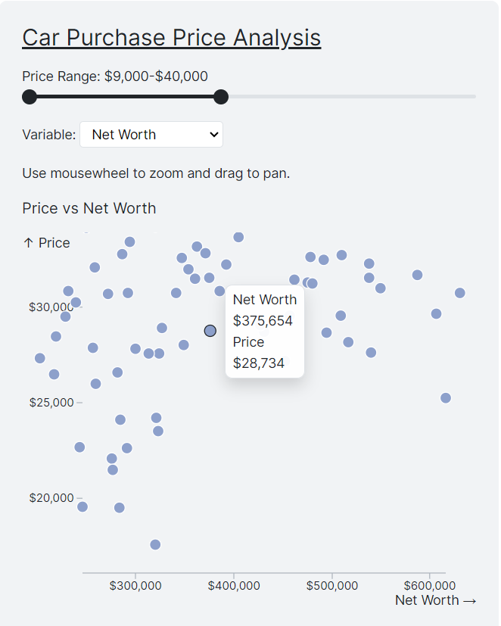
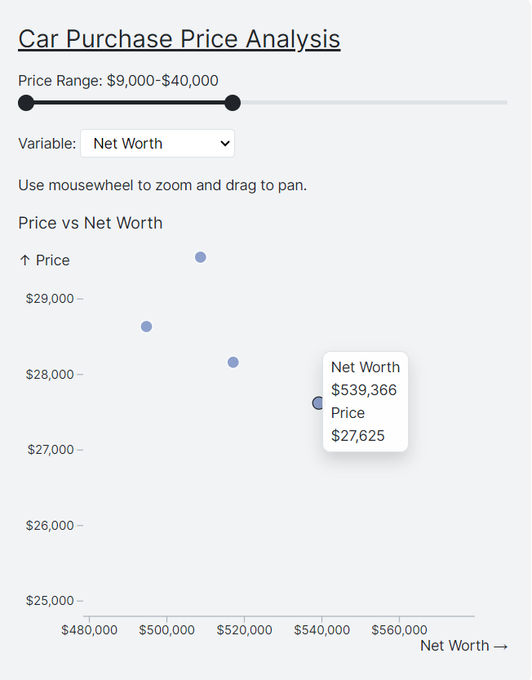

Slide 20

DEMO

Slide 21

Challenges
Cleaning and organizing the data was time-consuming due to inconsistencies and missing information.
Integrating data from different sources was complex because each source had its own format.
Creating dynamic and interactive visualizations required advanced technical skills in data visualization tools.
Analyzing high-dimensional data made it difficult to present clear and simple insights without overwhelming the audience.
Ensuring accuracy in interpreting the data was challenging, especially in correlating financial information with car purchase behaviors.
Managing a large dataset slowed down processing and required efficient data handling techniques to improve performance.

